Slide 1


History of Palliative Care
وبینار کلیات مراقبت حمایتی سکینی در بیماریهای سخت درمان
19مرداد 1400
Dr. Abdolrahim Hazini

Slide 2
Outline
  - Introduction
  A 30-year experience of clinical oncology
  Origin of palliative care activities in Iran (reasons/start/continuance)
  Palliative care achievements
  Future challenges
  Prospective

Slide 4
The purposes and reasons of entering palliative care
Introduction
A 30-year experience of clinical oncology
The incidence of cancer and mortality from cancer in Iran before palliative care entrance
Origin of palliative care activities in Iran
The motivation to enter palliative care and activities in this field

Slide 5
Palliative care center of Esfahan
Date of establishment
Location of center
Patients numbers from origin till 2019
How to participate and collaborate
Teaching and cooperating with the university
Cooperation with health centers and hospitals
Center colleagues

Slide 6
Patients statistics covered in Esfahan Province
From 20123 to 2019
11500 patients
31% home-care patients
%66 end-staged patients
54% died at home

Slide 7
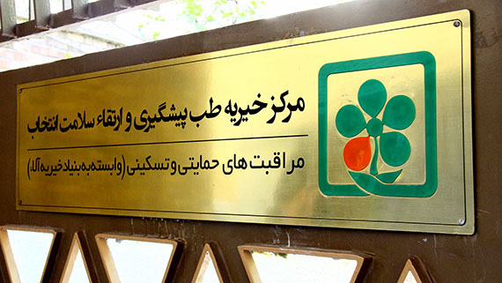

Slide 8
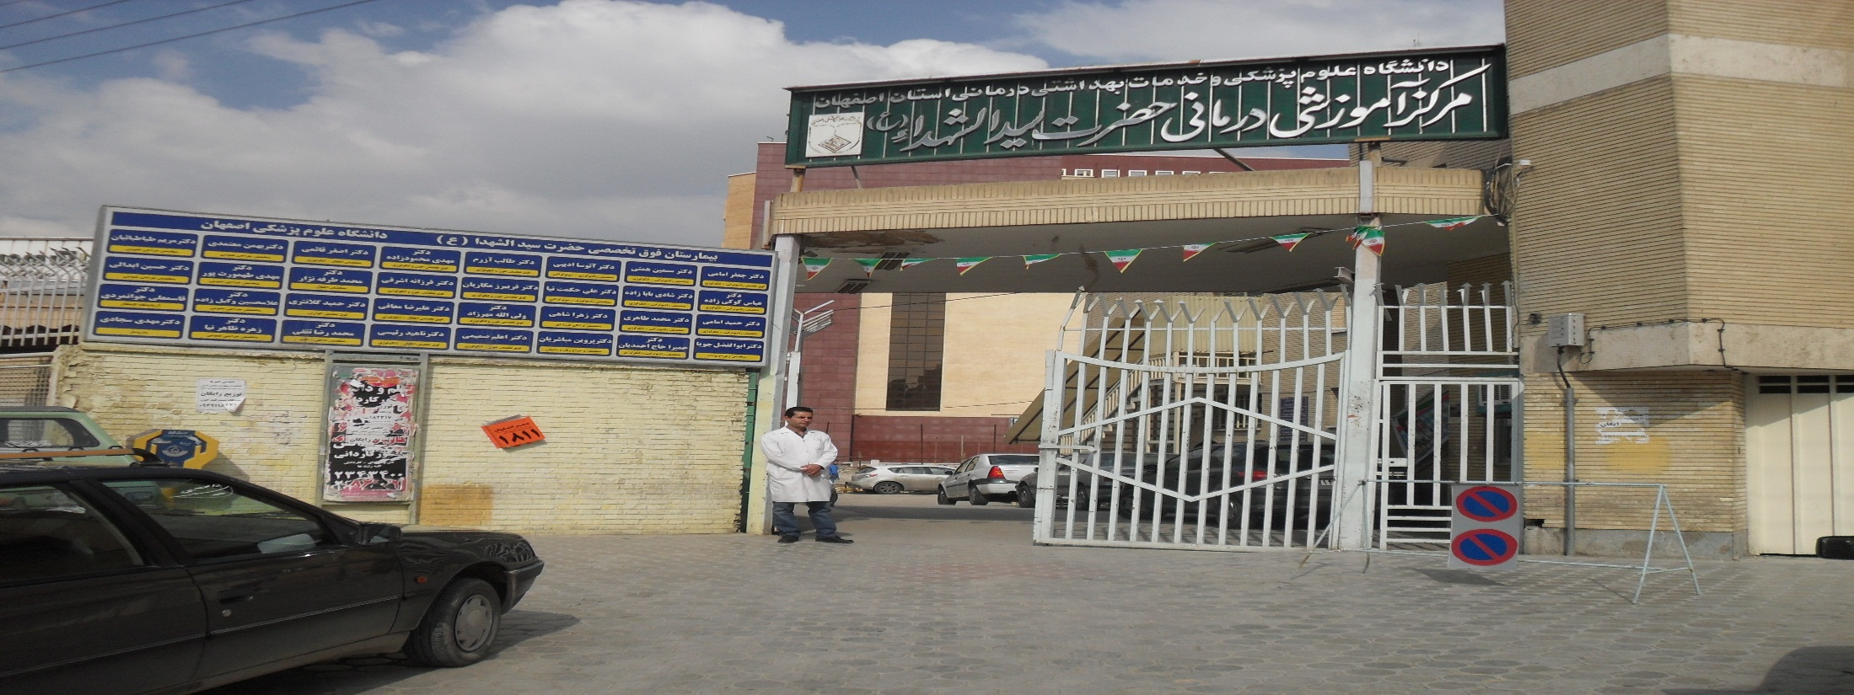
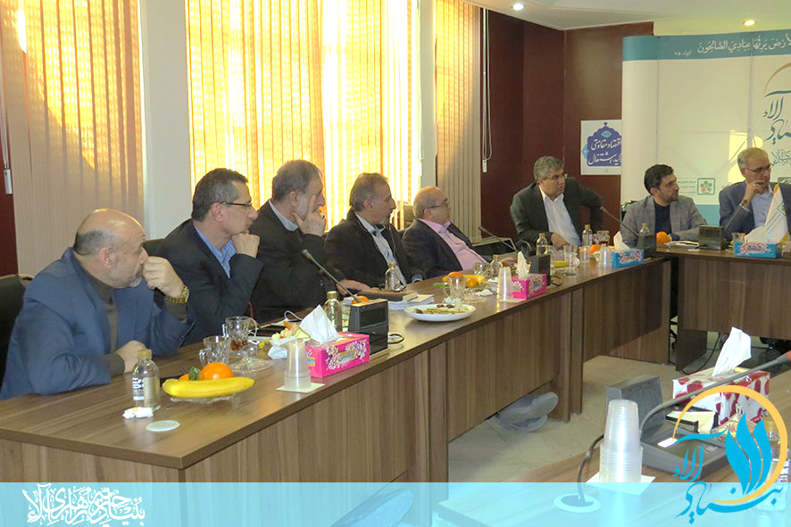

Slide 9
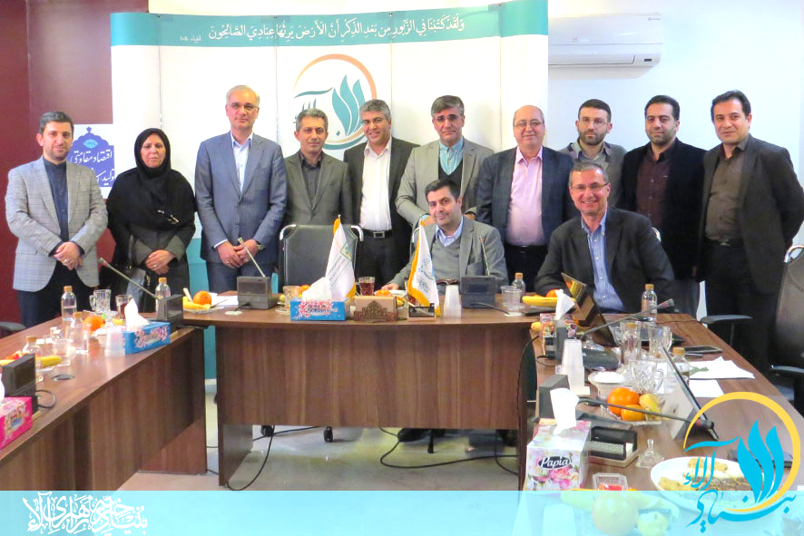

Slide 10
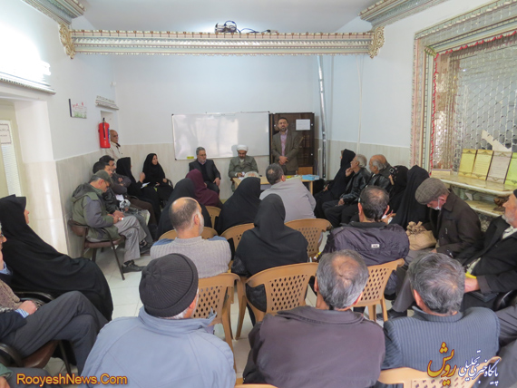
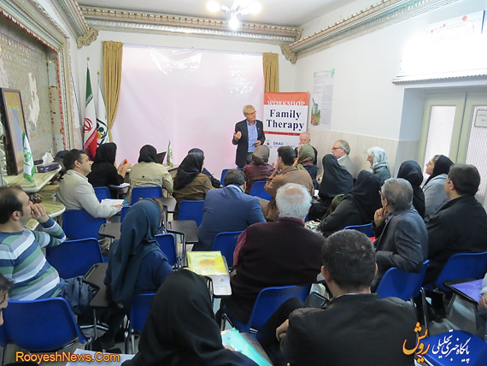

Slide 11
Palliative care center of Tehran
- Establishment date
- Centers location
- Achievements in palliative care in Tehran till 2019
- Cooperation with health centers and hospitals
- Colleagues of centers and hospitals

Slide 12
Patients statistics covered in Tehran Province
From 2013 to 2019
7600 patients
79% (6004): cancer patients
21% (1596): other diseases
90% (6825): end-staged patients
Nearly 4700 died at home
Covered in Ala charity organization

Slide 13
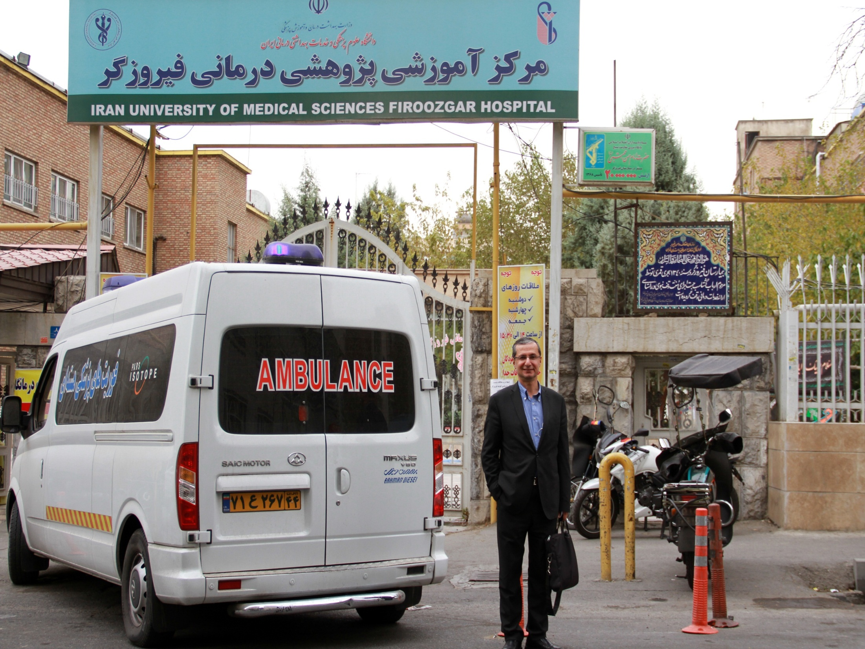

Slide 14
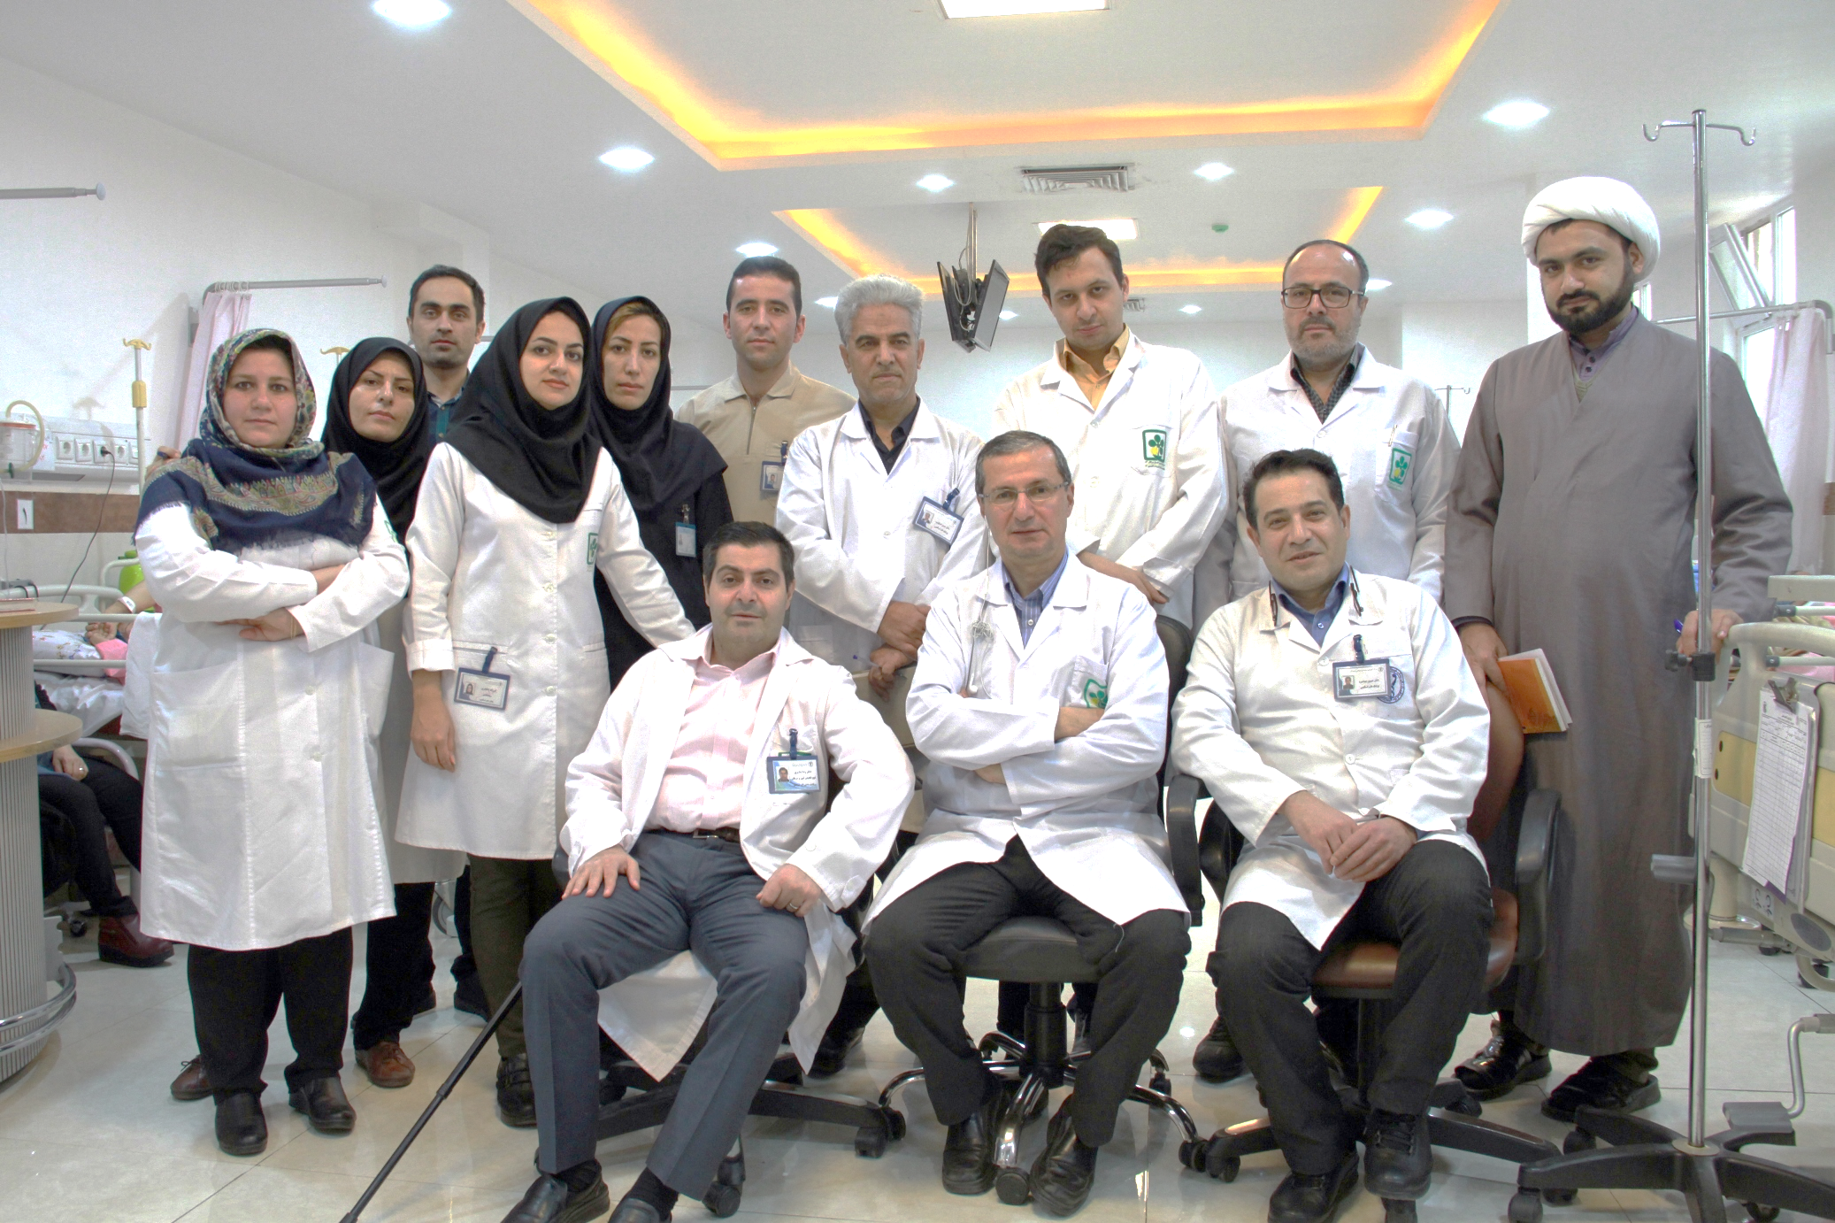
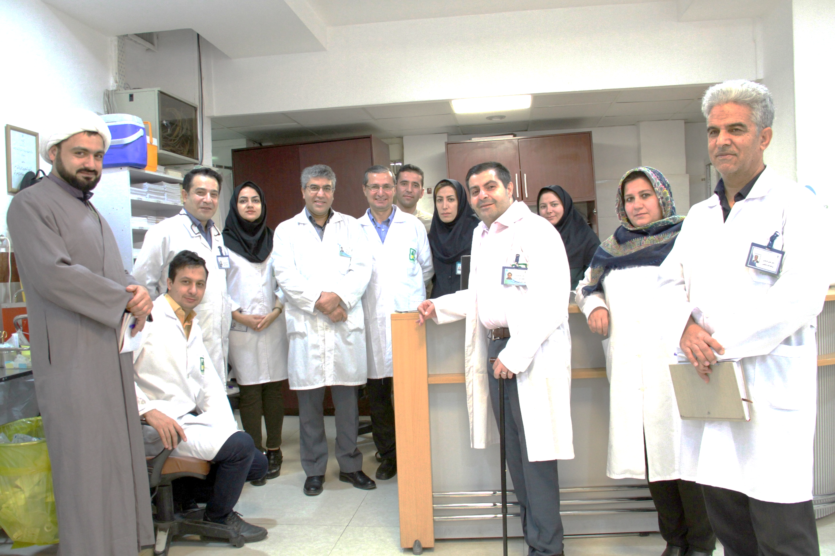

Slide 15
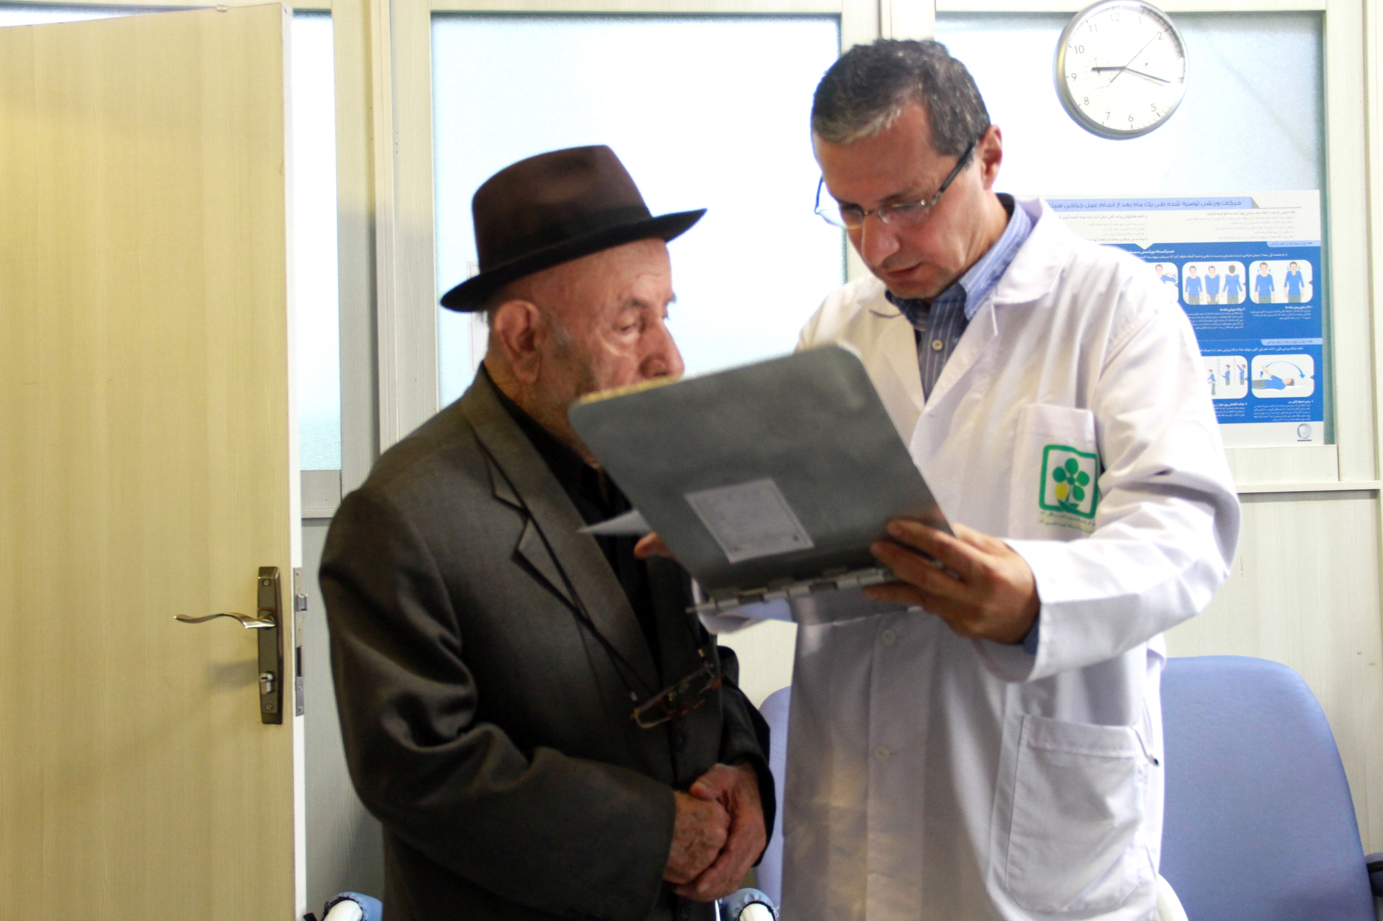
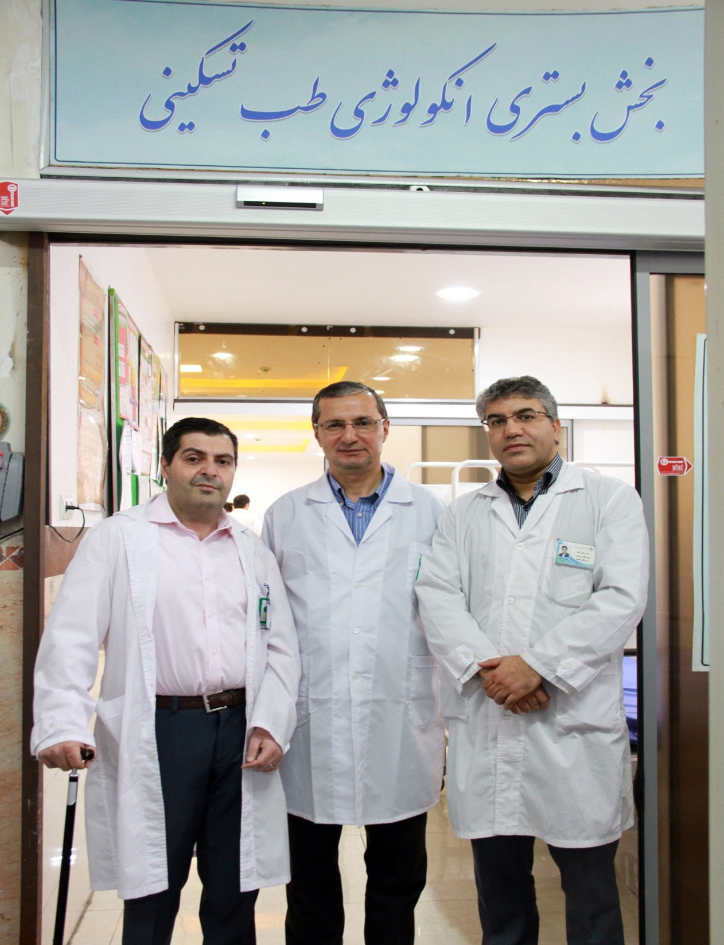

Slide 16
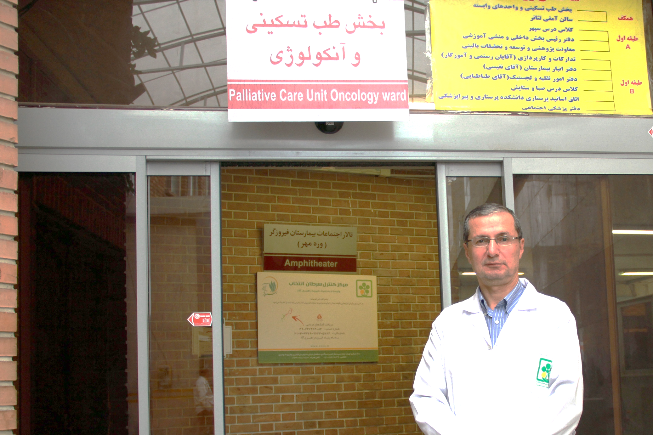
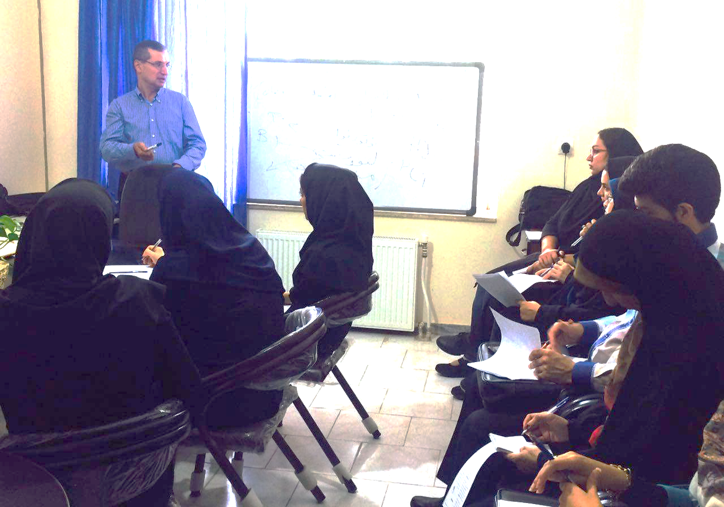

Slide 17
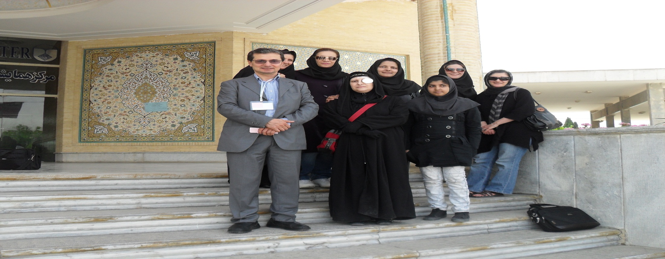
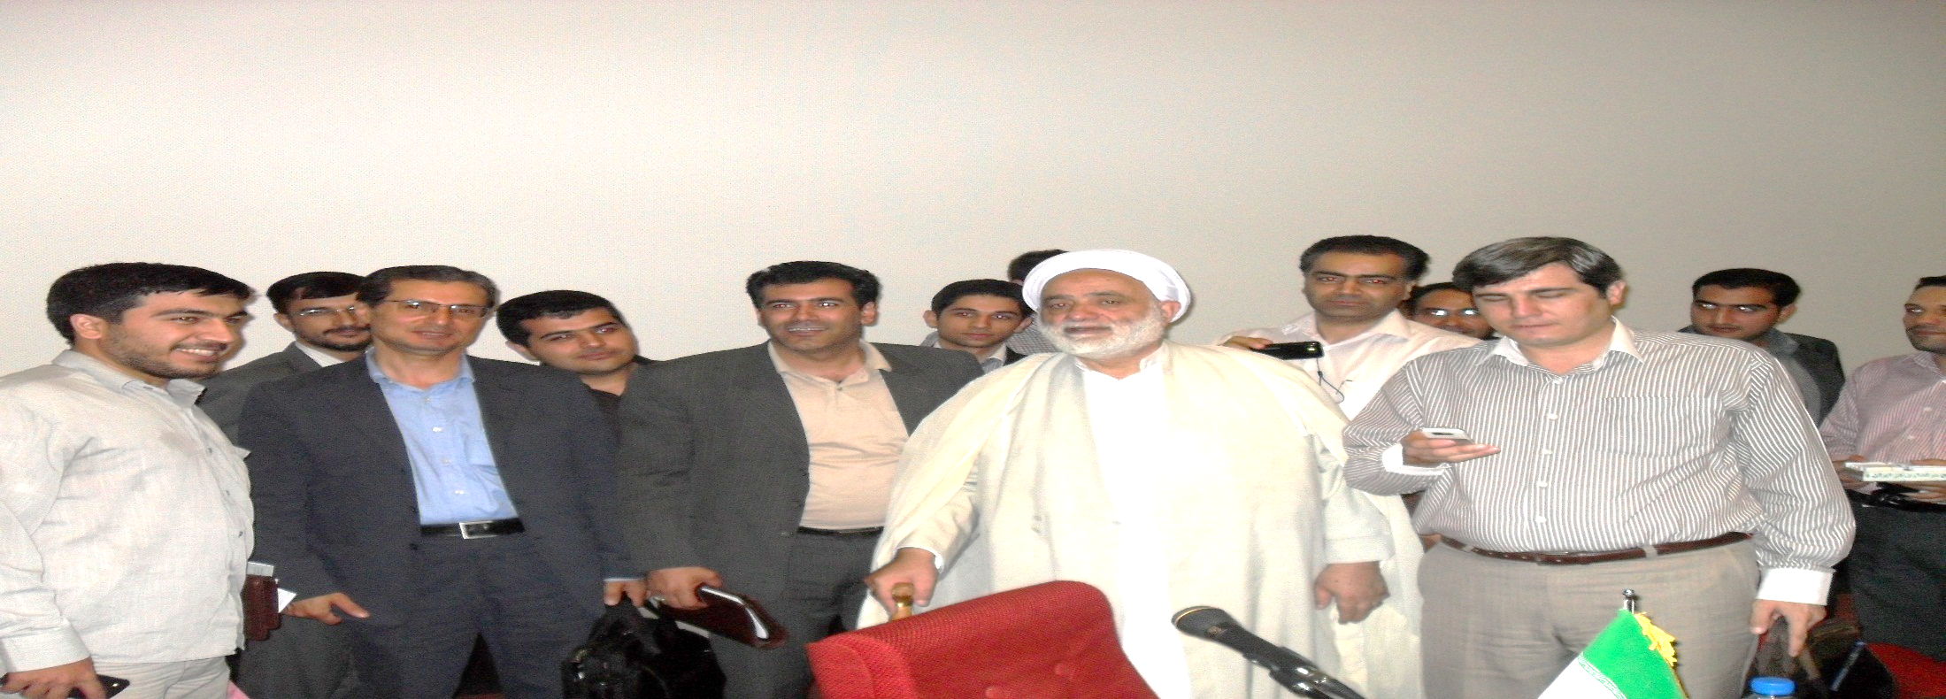

Slide 18
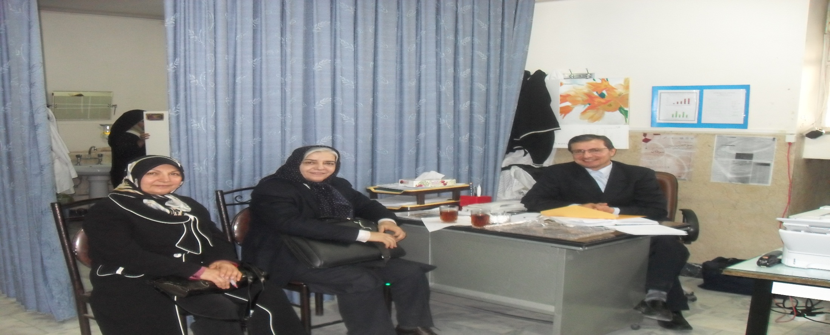
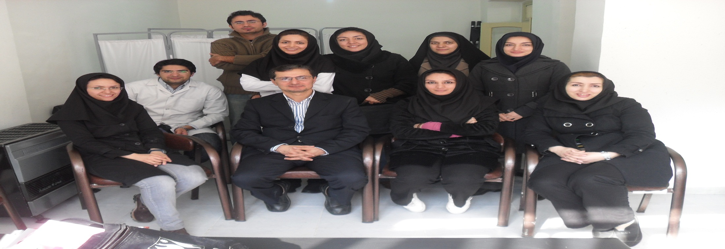

Slide 20
Palliative care center of Golestan
Date of debut
Centers location
Centers and hospitals involved in palliative care
Achievements in palliative care in Golestan till 2019
Colleagues of centers and hospitals
Prospective of Golestan in palliative care

Slide 21
Patients statistics covered in Golestan Province
From 2015 to 2019:
Nearly 3000 patients:
70% (2100): cancer patients
20% (600): advanced chronic diseases
10% (300): Psychological counseling
more than 210 of patients died at homes
600 died
Home-care patients: (during 6 months)
400 patients
70% (280) of patients died at homes

Slide 23

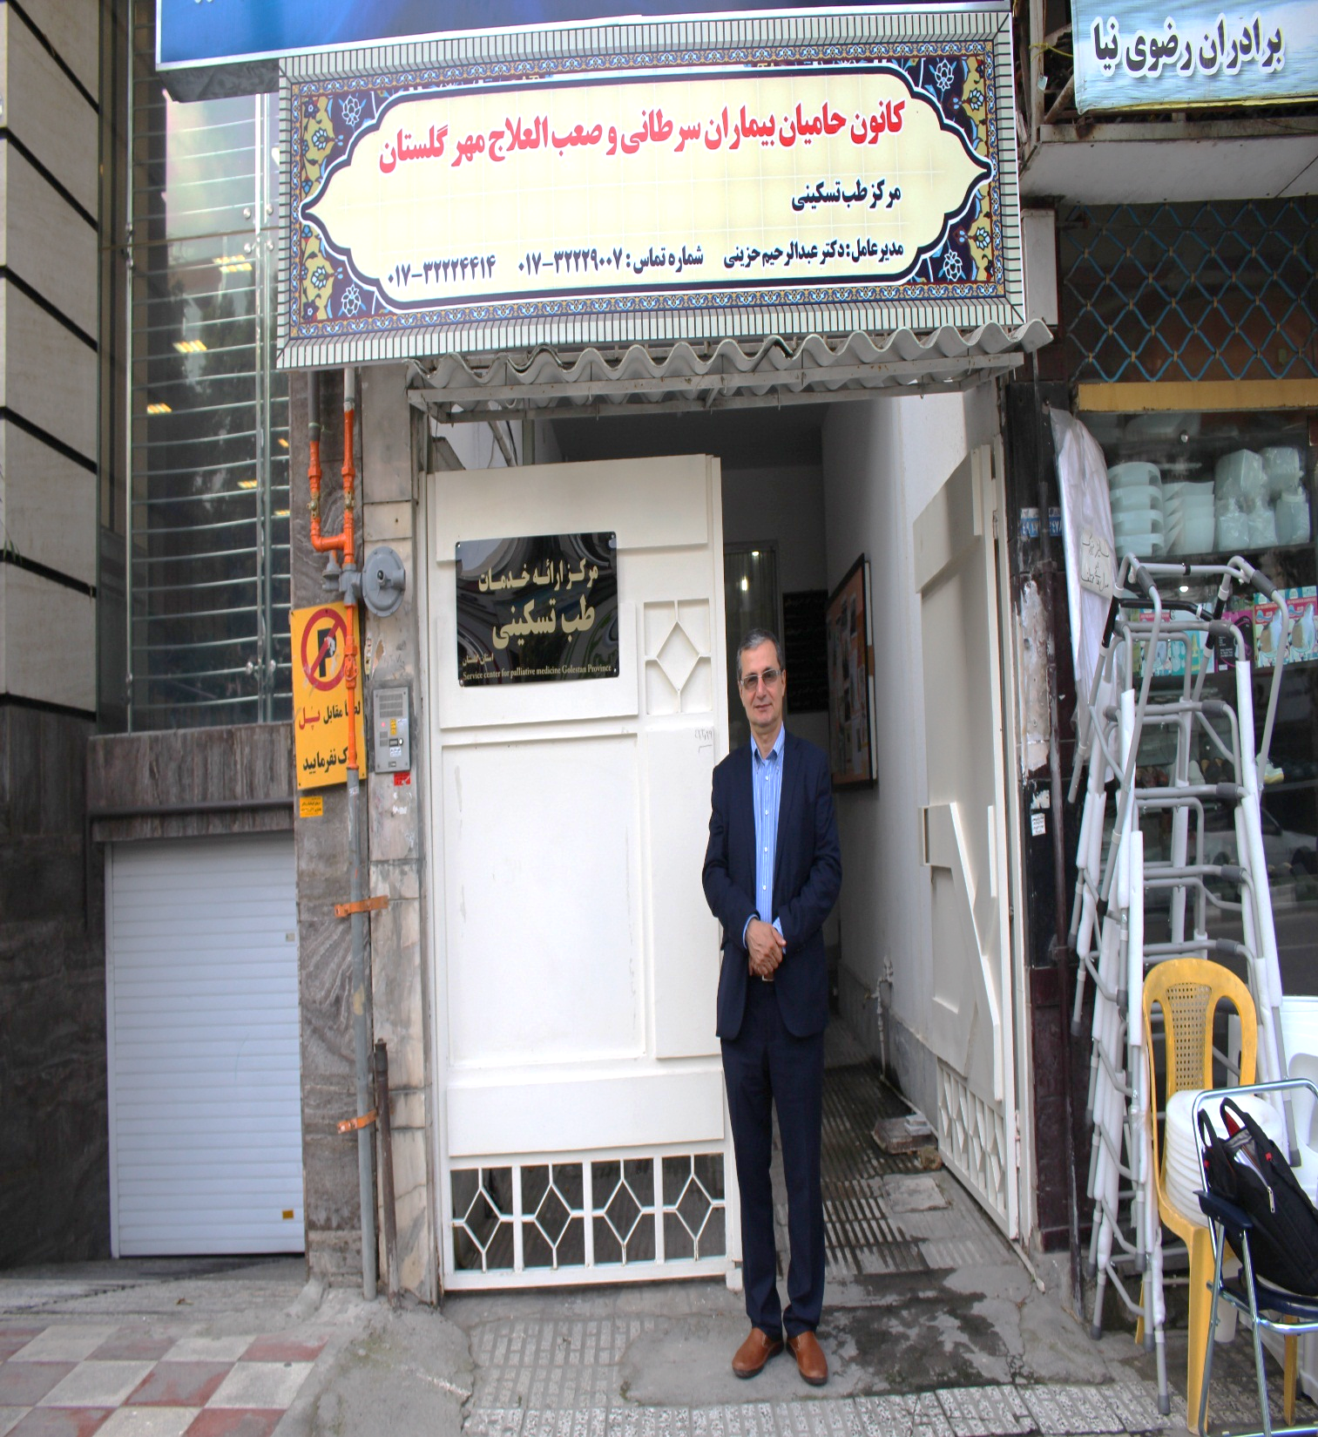
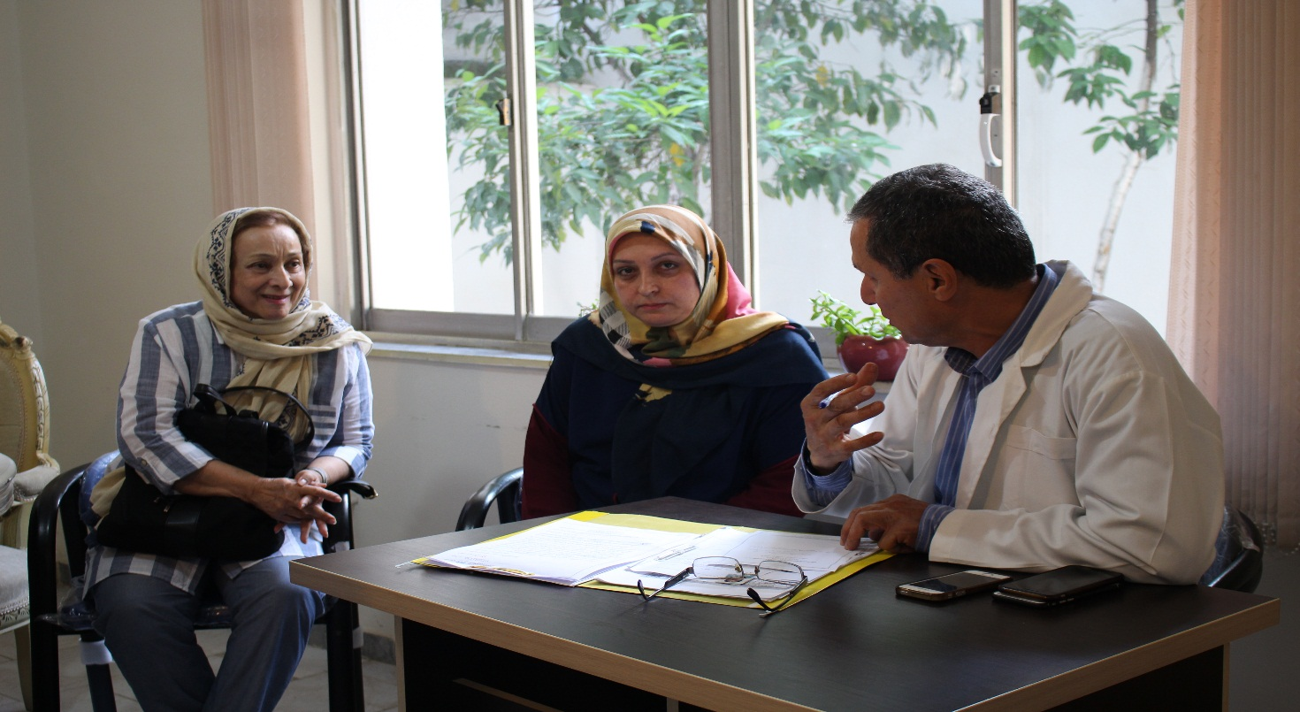
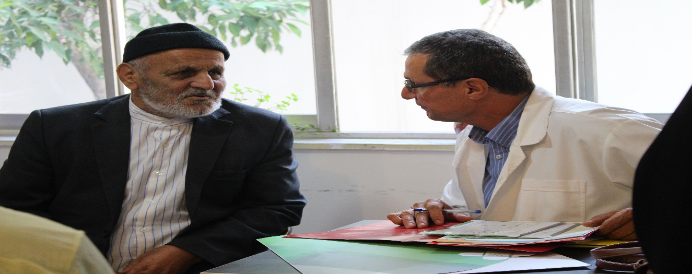

Slide 24
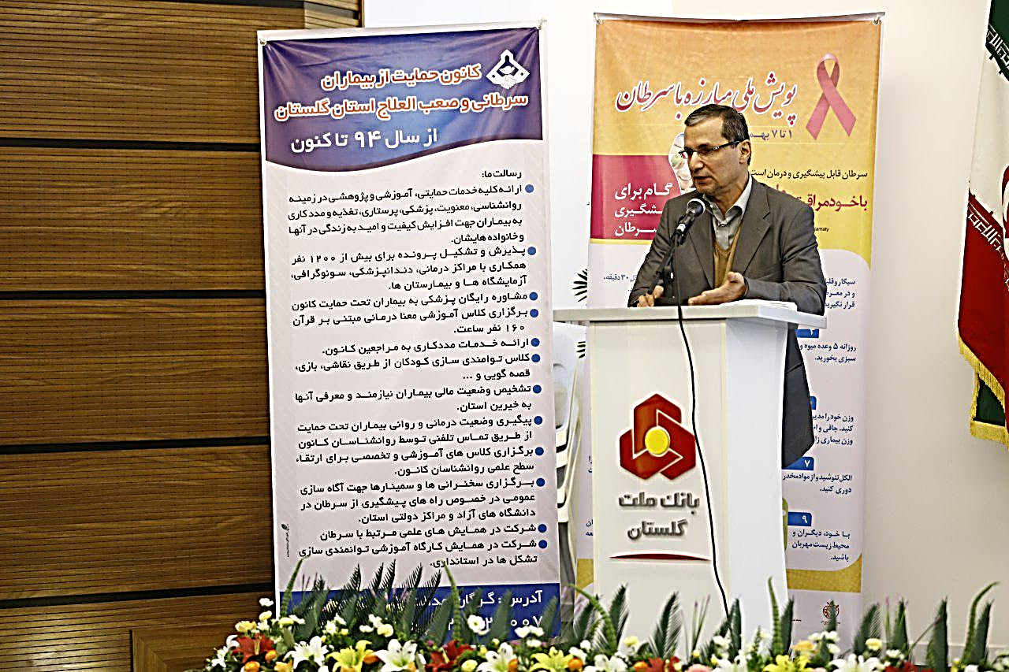
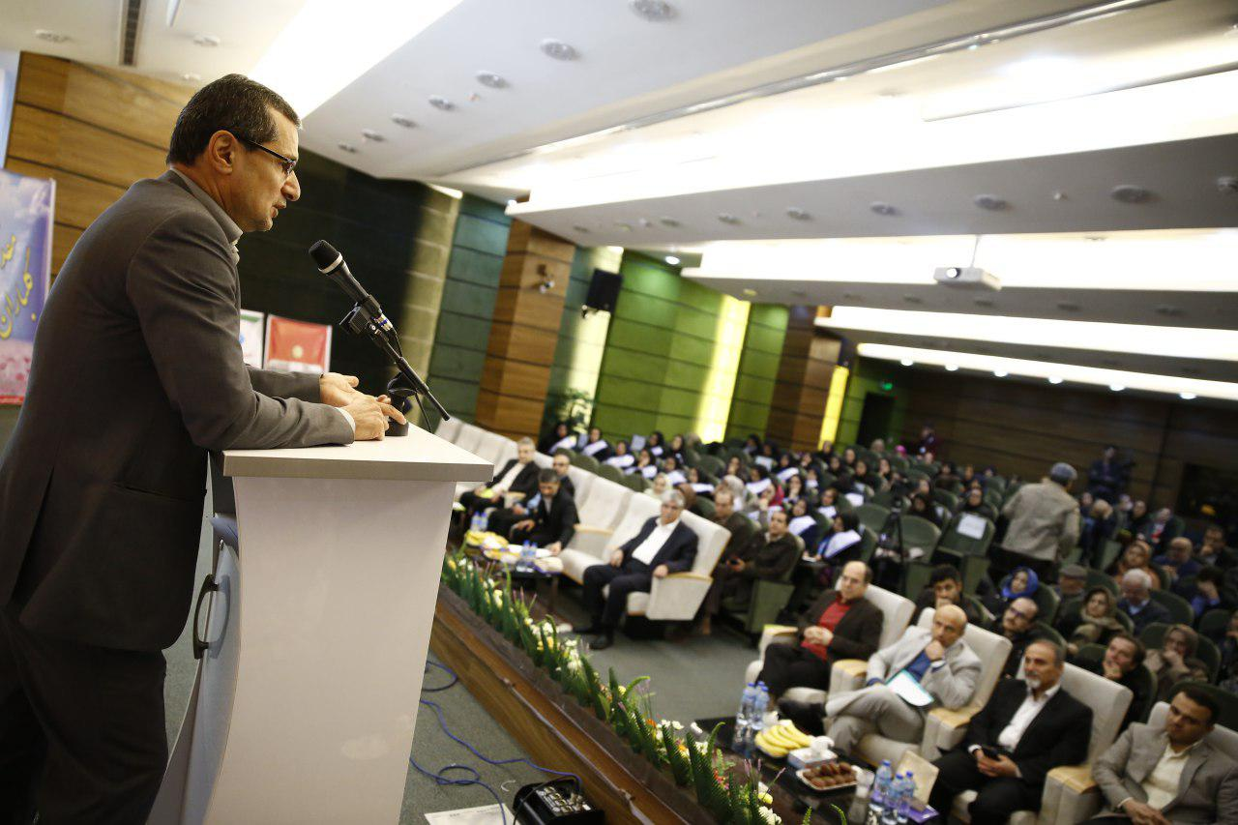

Slide 25
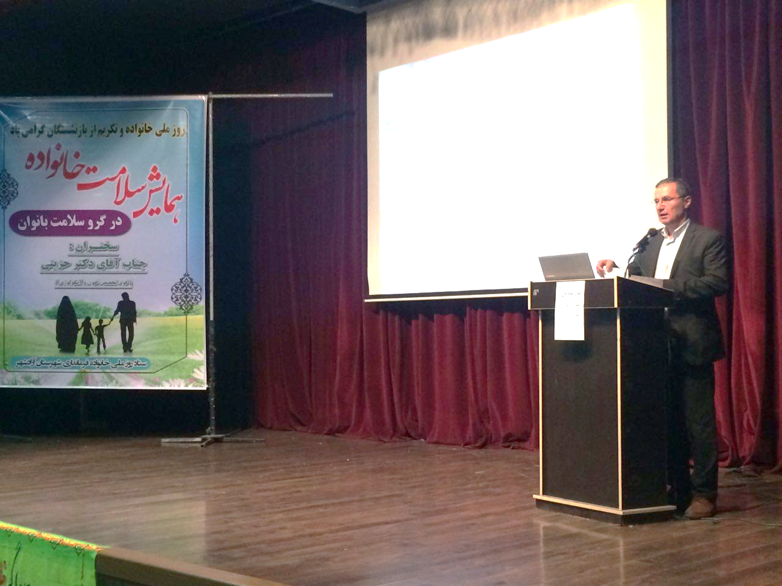
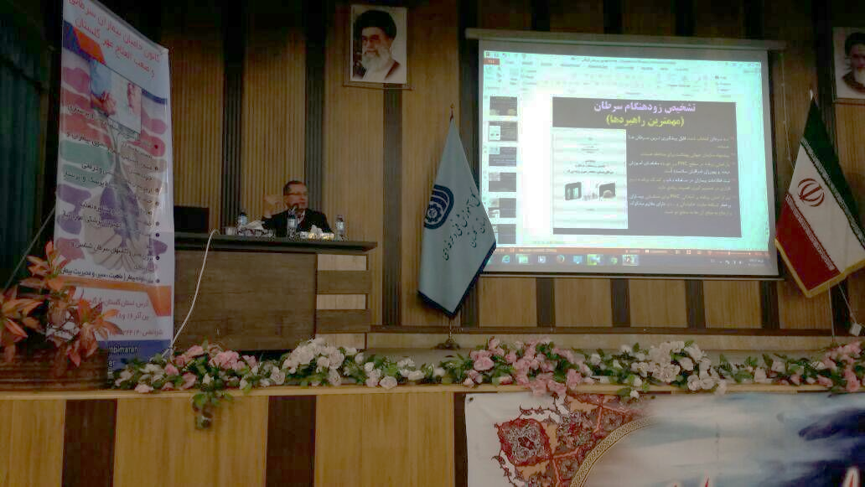

Slide 26
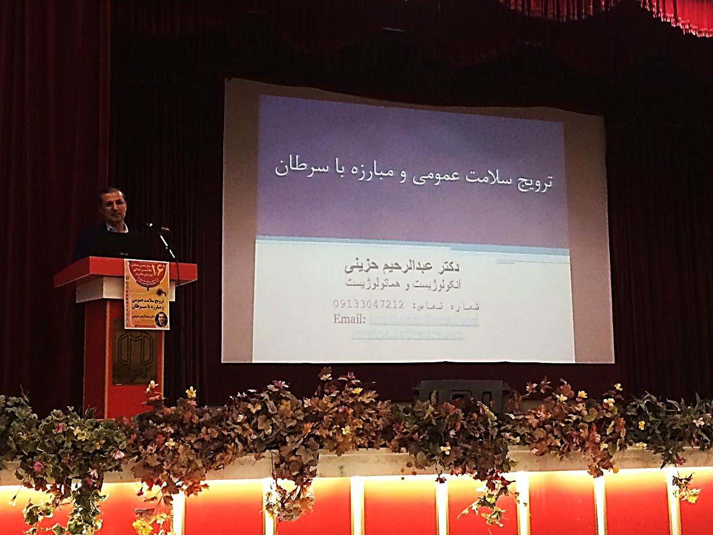
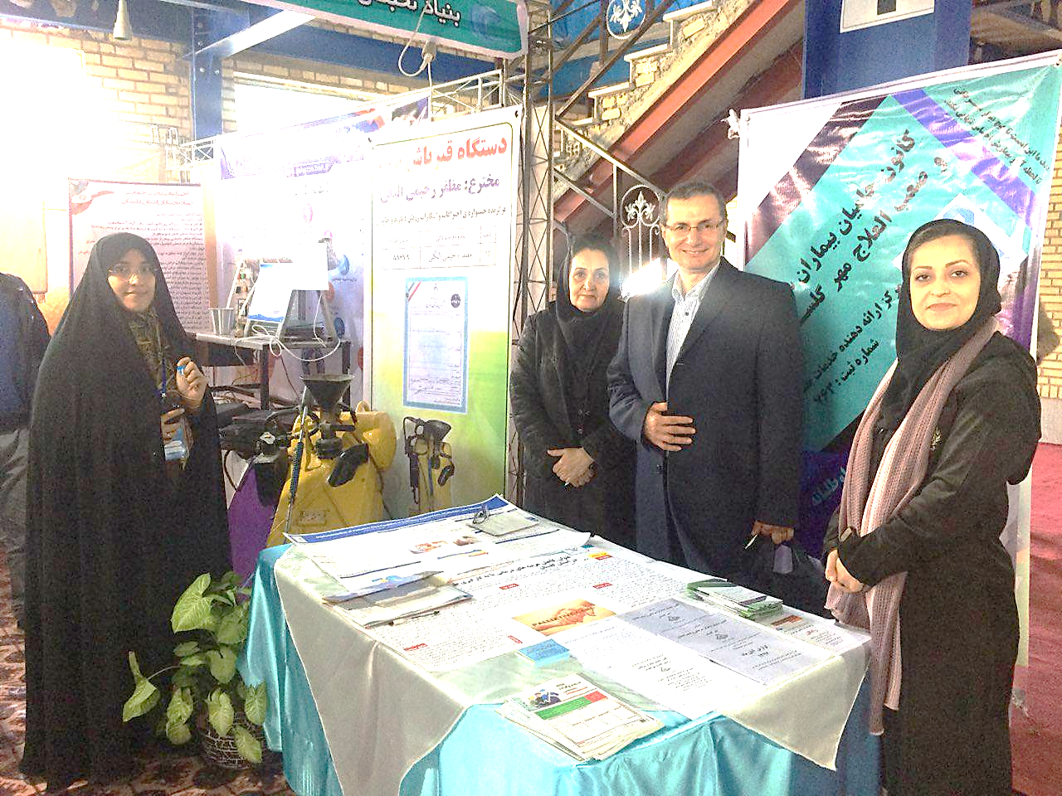

Slide 27
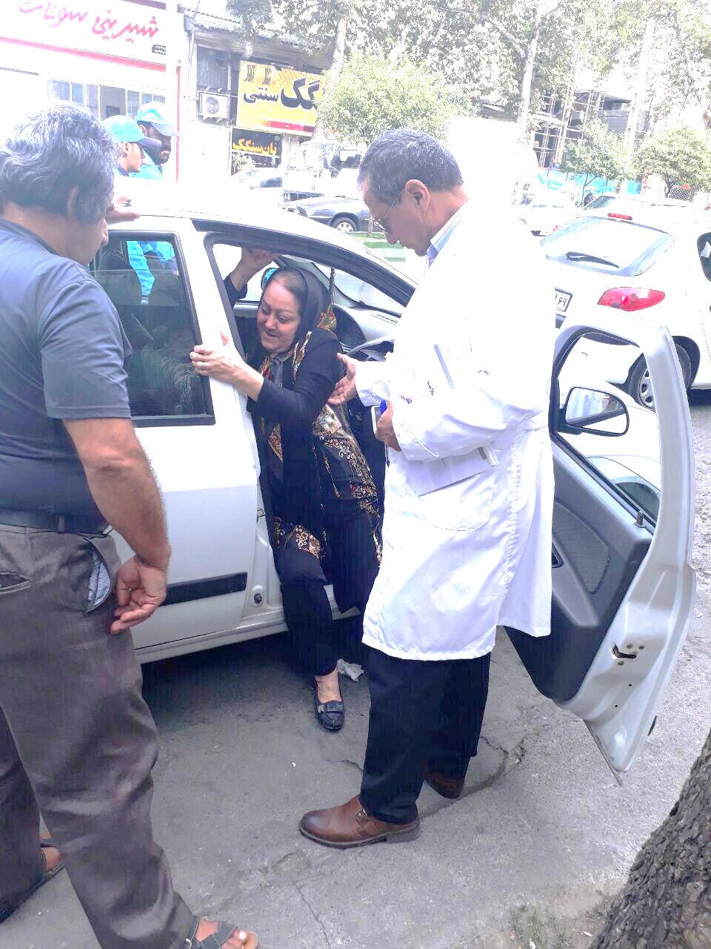
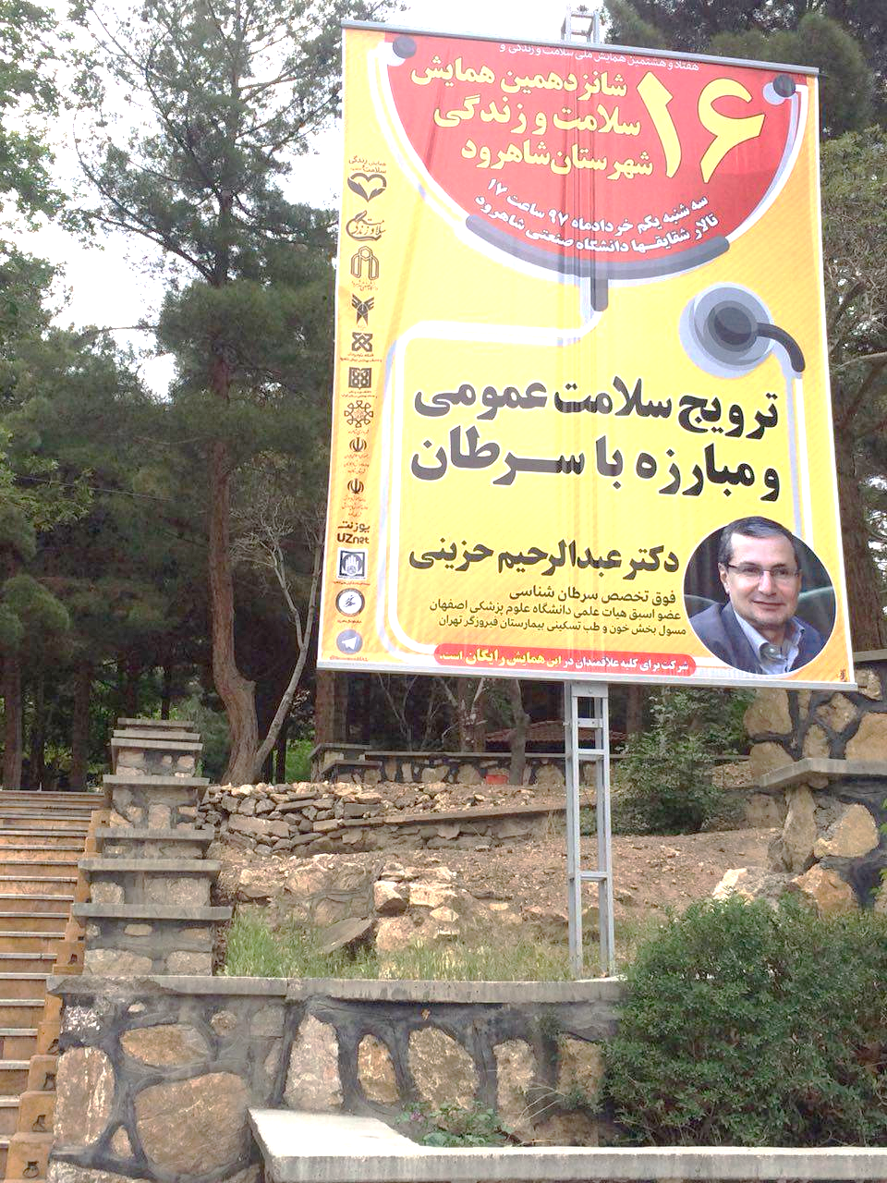
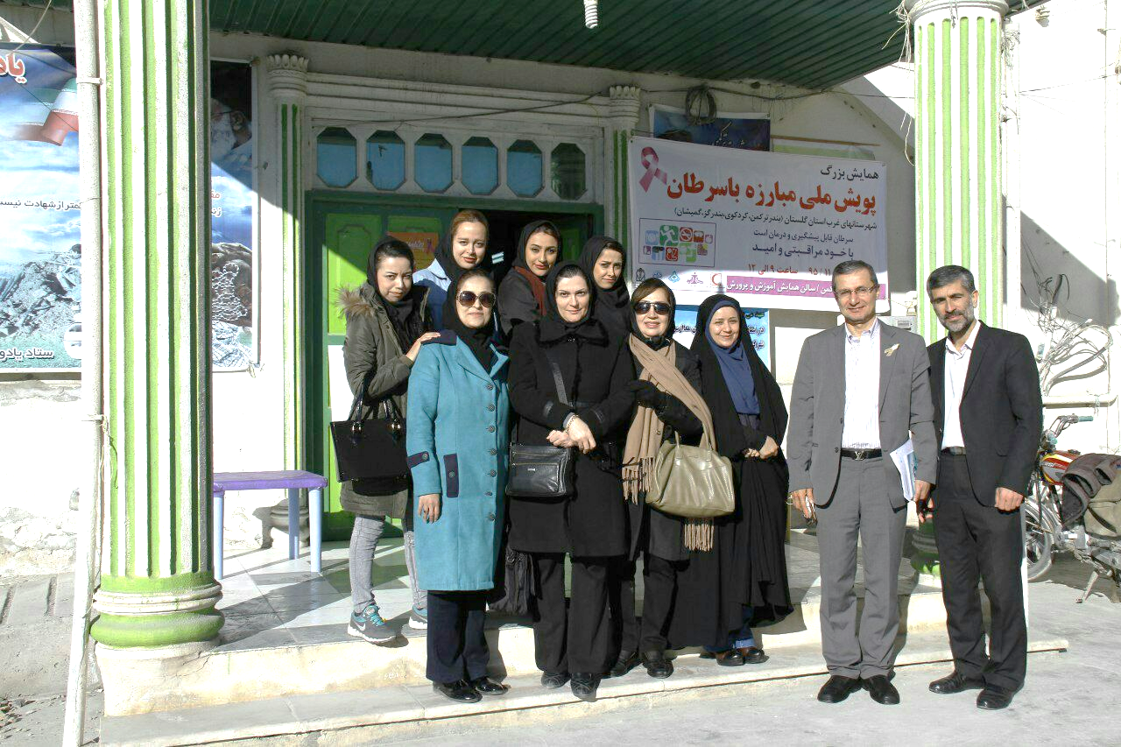

Slide 29
Results of palliative care in Iran
Removing cancer phobia and turning it into living with cancer
Removing social problems based on cured people
The release of many private and public hospitals beds for other patients and diseases
Changing the mode of treatment from clinic/hospital-visit to home-visit and home-care
Increasing survival rate in cancer patients
Promoting good death among cancer patients
Increasing the quality of faith and life expectancy
Increasing the quality of dying especially in end-staged patients
Maintaining the human dignity of the patients
Injection of hope and vitality to patients (hope therapy)
Improving the life quality of the patient's last days

Slide 30
Results of palliative care in Iran
- Decreasing major hospital mortality in cancer patients
- Satisfaction of the patient and relatives from treatment process/condition up to 97%
- Transferring the patient's hospital bed from the hospital to her/his own home (hospice/ICU-care at home)
- Doctor on call, Phone counseling, 24 h- 7 days- 30 days- 365 days
- Improving the quality of treatment for cancer patients
- Decreasing the burnout of hospital staff and patients
- Decreasing the costs of treatment for the patient and the hospitals up to 30%
Improving fake-CPR
Fighting with the misconceptions of cancer patients
Optimal management of the patient and the treatment process
Providing a comprehensive model for palliative care in Iran
Collecting philanthropists in several provinces to help patients

Slide 32
A comprehensive model for palliative care in Iran
Model of work for palliative care in order to cancer control program in Iran
Integrative Hospitals Base palliative home care
Hospice-care at home
Integration of palliative care teams into hospitals in the country (Iran)
Integration of palliative care with clinical services all over the country (Iran)

Slide 33
Obstacles and Challenges
- Resistance and opposition of many cancer specialists
Opposition of the Health system officials in Iran
Opposition of many hospital officials
Opposition of many relevant drugs and other companies

Slide 34
Future Prospective
Establishment a comprehensive model for palliative care in Iran
Integration of palliative care with clinical services all over the country (Iran)
Changing health treatment approaches in the health system
Changing the attitude of the country's cancer experts towards palliative care and clinical oncology
Collecting philanthropists in whole country to help patients especially end-staged ones

Slide 35
Dr. Abdolrahim Hazini
دوره مقدماتی مراقبت تسکینی در بیماریهای سخت درمان زمستان 1398
Hematologist - Oncologist From Italy
Head of Dep. Of oncology and Palliative Care Unit
Firoozgar Hospital Tehran – Iran
TEL: 0098-21-22416676
0098-9133047212
EMAIL: amidhazini@gmail.com
web site: www.Palliativeiran.ir

