Slide 1
Psycho-Oncology
M.R. Sharbafchi, MD.
Assistant Professor of Psychiatry
Fellowship in Psychosomatic Medicine and Psycho-Oncology (Freiburg, Germany)

Slide 2
Cancer Epidemiology
Age-standardized incidence rate (ASR)
142 per 100,000 in Iranian population
Estimation of 100-110,000 new cases per year
154.8
127.7
World Health Organization. Regional Office for the Eastern Mediterranean. Eastern Mediterranean Region: framework for health information systems and core indicators for monitoring health situation and health system performance 2018 .

Slide 3
Cancer Epidemiology
Iran
Cancer Population 900,000
Death
56,000/Year
Advanced disease (End of life care) 52,000/Year
New Cases 110,000/Year

Slide 4
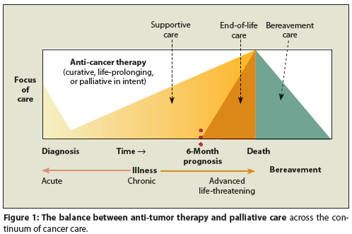
Palliative Care

Slide 5
Rationale for Developing a Psycho-Oncology Model of Care
Death
Dependency
Disfigurement
Disability and abandonment
Disruptions in relationships
Disruptions in role functioning
Disruptions in financial status

Slide 6
Psychiatric Disorders in Cancer Patients
Common Symptom _{(Comprehensive-2017)} | % Positive
Fatigue | 74
Worry | 71
Sadness | 66
Pain | 63
Drowsiness | 61
Dry Mouth | 56
Insomnia | 54
Poor appetite | 45
Nausea | 44
Bloating | 39
Difficulty in concentration | 38
Change in taste | 36
Constipation | 33
Cough | 30
Sexual dysfunction | 24
Nightmare | 11

Slide 7
Psychiatric Disorders in Cancer Patients
Long term distress: 66%
Adjustment disorders: 30 -35%
Clinically significant anxiety disorder: 30%
Major Depression: 20-35%
Delirium: 10%
Treatable syndromes, such as major depression and delirium, continue to be underdiagnosed and undertreated

Slide 8
SUICIDE
The relative risk of suicide in this population is twice that of the general population
More likely to occur in
Advanced cancer patients
Depression
Hopelessness
Poorly controlled symptoms particularly pain
Older patients
Mail gender
Suicidal thoughts in patients with advanced disease, poor prognosis, or poorly controlled symptoms should not be viewed as rational

Slide 9
SUICIDE
High risk Cancers:
Head and neck
Lung
Breast
Urogenital
GI cancers
Myeloma
Unmarried men with head and neck cancers: the highest incidence of suicide.
Half of the patients were in remission at the time of suicide

Slide 10
SUICIDE
Maintaining:
Supportive relationship
Symptom control (e.g., pain, nausea, depression)
Involving the family or friends are the initial steps in management of a suicidal patient

Slide 11
Cancer-related fatigue
Persistent subjective sense of tiredness related to cancer/treatment that interferes with usual functioning.
Cancer-related fatigue is usually refractory to sleep and rest
Present at the time of diagnosis in about 50 percent of cancer patients.
Occurs in up to 75 percent of patients with bone metastases.
Prevalent in long-term cancer survivors and has a serious impact on a person's quality of life.

Slide 12
Delayed Consequences of Treatment
Infertility problems, premature ovarian failure
Pituitary, thyroid and other endocrine failures
Increased vulnerability to large organ failure and secondary malignancies
Social rejection, employment discrimination, and serious financial problems

Slide 13
Three Phases of Response to Knowing of Cancer
First phase
Shock and Disbelief that usually lasts less than 1 week.
Try to control the level of emotional distress while making crucial treatment decisions
Presence of a relative or friend can help with the processing of important information.
The way the news is conveyed can influence a patient's beliefs, emotions, and attitudes toward the future and the medical staff.

Slide 14
Three Phases of Response to Knowing of Cancer
Second phase
Characterized by a period of confusion with mixed symptoms of:
Anxiety
Depression
Irritability
Insomnia
Poor concentration
Inability to function
Resolve with support from family and friends and from the physician who outlines a treatment plan that offers hope.
This phase usually lasts 1 to 2 weeks

Slide 15
Three Phases of Response to Knowing of Cancer
Third phase
The patient adapts to the diagnosis and treatment.
The patient returns to previously used coping strategies that are helpful in reducing stress.
These coping strategies are influenced by the previous level of maturation and adaptation.

Slide 16
End-of-Life and Palliative Care
Death from a chronic illness makes the sufferer and his or her loved ones live in the presence of death for a prolonged period.
Some elderly people accept death, but many elderly patients find death premature. and many families wish desperately to extend the life of a beloved parent.
With cancer, sufferer loses more and more of the roles that defined his or her social existence before dying a physical death. (Social death)

Slide 17
Symptoms in Patients with Advanced Disease
Dying patients experience more symptoms than they can describe and more than their caregivers are likely to explore.
Nervousness, sadness, insomnia, fear of dependence, or loss of dignity, are among the most prevalent.
Physical, psychological, and existential concerns cannot be considered independently of one another.

Slide 18
Symptoms in Patients with Advanced Disease
Kubler-Ross
Interviews with 400 dying patients revealed that patients know without being told that they are dying
They need to talk about it, and that they need to maintain hope, even if there is no hope of cure.
Fatal illness is not a sudden event and practitioners can provide support to patients by assuring them that they will maintain their relationship with them during the dying process

Slide 19
Stages from Awareness of Fatal Prognosis to Actual Death
Denial. "No, not me" is the dying patient's common initial response. If it does not interfere with treatment, then denial can mitigate the initial overwhelming anxiety.
Anger. "Why me?" Indignation may surface when denial subsides. Patients are irritable, demanding and critical; anger may be directed at themselves, caretakers, family and friends or God.
Bargaining. "Yes me, but .... , This stage entails promises to buy additional time. The patient may promise to donate kidneys or eyes to research or reaffirm an earlier faith in God.

Slide 20
Stages from Awareness of Fatal Prognosis to Actual Death
Depression. "Yes, me." The patient comes to a full realization of what is going to happen and to whom. With the impending loss of life, a pervasive despondency may set in.
Acceptance. The patient begins to accept the inevitable. It need not be defeat or total surrender. "Yes, me, and I'm ready."

Slide 21
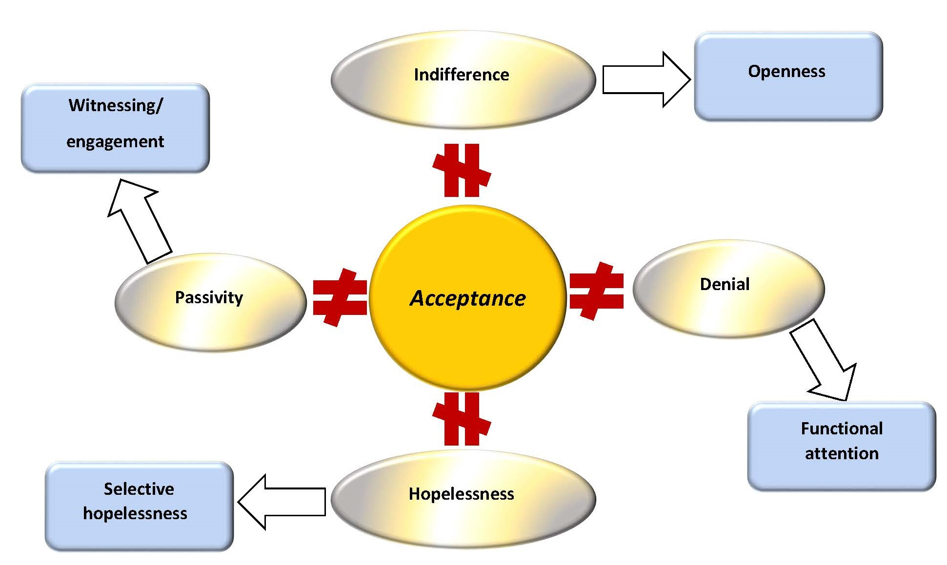

Slide 22
Symptoms in Patients with Advanced Disease
These five stages are not all-encompassing or prescriptive.
Patients do not travel these stages in a linear fashion.
A patient may demonstrate aspects of all five stages in one interview, fluctuate or come to them in differing orders.
Few will reach acceptance.
Moreover, patients may exhibit other coping methods, such as terror, humor or compassion to offset each stage.

Slide 23
Factors in Adaptation to Cancer
The Society-derived Factors
Society's attitudes toward cancer and its treatment
Perceptions and knowledge of cancer at a given time
Less threatening and stigmatized
The belief that stress, depression, major life events (grief,…), or flaws in personality cause cancer.
During the past 10 years, more than 15 reviews of psychosocial risk factors for cancer have been published
The majority of well-designed studies do not confirm that depression, stress, personality, and major life events cause cancer.

Slide 24
Factors in Adaptation to Cancer
The Patient-derived Factors
Positive Intrapersonal factors:
Preexisting character style
Coping ability (Active and problem-solving, emotional, Meaning based)
Ego strength
Hopefulness
Impact and meaning of the cancer
Identification with who are seen to be improving/de-identification with who are not doing well in their cancer treatment

Slide 25
Factors in Adaptation to Cancer
The Patient-derived Factors
Negative Intrapersonal factors:
Younger age
Coping strategies which include avoidance of emotions and stressors
Desire to maintain a high degree of control
Experience loss of hopefulness (often related to clinical uncertainty)
Experience restriction in access to social and leisure activities

Slide 26
Factors in Adaptation to Cancer
The Patient-derived Factors
Interpersonal factors:
Social support derived from others
Socioeconomic and social class:
Lower socioeconomic status can be a barrier to access health care

Slide 27
Factors in Adaptation to Cancer
The Cancer-derived Factors
Stage of the disease
Symptoms
Site
Prognosis
Type of treatment
Impact in functionality

Slide 28
Psychosocial Needs to Patients and Families
Understanding of illness, Treatments and Services
What is going on? What should I do now?
Coping with emotions surrounding illness and treatment
Depression, Anxiety, Anger
Managing illness and health
How to cope with treatment side effects, How to feel well,

Slide 29
Psychosocial Needs to Patients and Families
Behavioral change to minimize disease impact
Behavioral/health promotion interventions such as smoking cessation assistance, patient education etc.
Managing disruptions in work, school and family life
Family and caregiver education, assistance with Activities of Daily Living.
Financial assistance
Financial planning, eligibility and assistance with applications for disability pension, etc.

